Slide 1
Module 2: Implement and Manage Hybrid Identities
Azure AD Connect, Password Sync and Password Writeback, and Azure AD Connect Health

Slide 2

Learning Objectives
You will learn the following concepts:
Hybrid Identity
Install and configure Azure AD Connect
Configure password sync and password writeback
Configure Azure AD Connect Health

Slide 3

Hybrid Identity

Slide 4
Hybrid Identity with Azure Active Directory (1 of 2)
You can use the following authentication methods to implement hybrid identity with Azure AD
Password hash synchronization (PHS)
Pass-through authentication (PTA)
Federation (AD FS)

Slide 5
Hybrid Identity with Azure Active Directory (2 of 2)
I need to: | PHS and SSO | PTA and SSO | AD FS
Sync new user, contact, and group accounts created in my on-premises Active Directory to the cloud automatically. | X | X | X
Set up my tenant for Office 365 hybrid scenarios. | X | X | X
Enable my users to sign in and access cloud services using their on-premises password. | X | X | X
Implement single sign-on using corporate credentials. | X | X | X
Ensure no password hashes are stored in the cloud. |  | X | X
Enable cloud-based multi-factor authentication solutions. | X | X | X
Enable on-premises multi-factor authentication solutions. |  |  | X
Support smartcard authentication for my users.⁴ |  |  | X
Display password expiry notifications in the Office Portal and on the Windows 10 desktop. |  |  | X

Slide 6
Install and Configure Azure AD Connect

Slide 7
Azure AD Connect
Password hash synchronization - A sign-in method that synchronizes a hash of a users on-premises AD password with Azure AD.
Pass-through authentication - A sign-in method that allows users to use the same password on-premises and in the cloud but doesn't require the additional infrastructure of a federated environment.
Federation integration - Is used to configure a hybrid environment using an on-premises AD FS infrastructure. It also provides AD FS management capabilities such as certificate renewal and additional AD FS server deployments.
Synchronization - Responsible for creating users, groups, and other objects. As well as, making sure identity information for your on-premises users and groups is matching the cloud.
Health Monitoring - Azure AD Connect Health can provide robust monitoring and provide a central location in the Azure portal to view this activity.

Slide 8
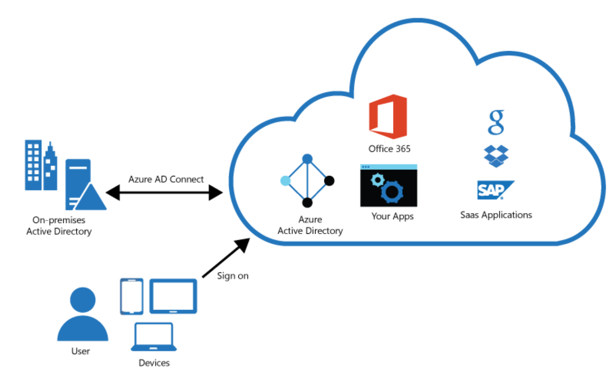
Azure AD Connect (cont.)
Integrating on-premises directories with Azure AD provides a common identity for accessing both cloud and on-premises resources.
Users can use a single identity to access on-premises applications and cloud services such as Office 365.
Single tool to provide an easy deployment experience for synchronization and sign-in.
Azure AD Connect replaces older versions of identity integration tools such as DirSync and Azure AD Sync.

Slide 9
Azure AD Connect Installation
Install Azure AD Connect:
Express settings
Custom settings
Upgrade from DirSync
Upgrade from Azure AD Sync or Azure AD Connect
Configure sync features:
Filtering
Password hash synchronization
Password writeback
Prevent accidental deletes
Automatic upgrade

Slide 10
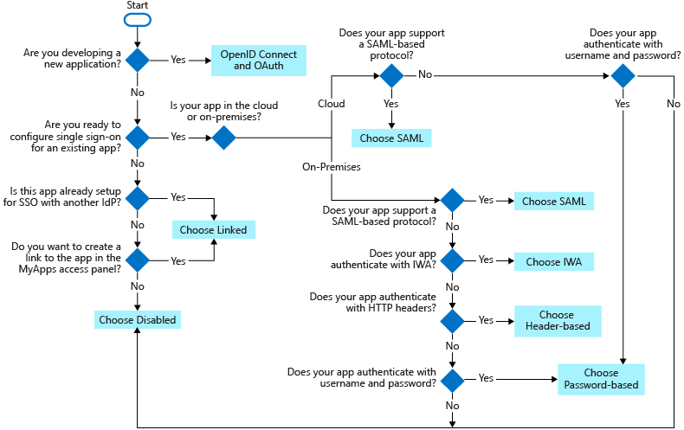
Single Sign-On
Choosing a single sign-on method depends on how the application is configured for authentication.
Cloud applications can use OpenID Connect, OAuth, SAML, password-based, linked, or disabled methods for single sign-on.
On-premises applications can use password-based, Integrated Windows Authentication, header-based, linked, or disabled methods for single sign-on. The on-premises choices work when applications are configured for Application Proxy.

Slide 11
Demonstration: Azure AD Seamless Single Sign-On
Prerequisites
Enable Azure AD Connect
Verify Seamless SSO is enabled

Slide 12
Configure Password Sync and Password Writeback

Slide 13
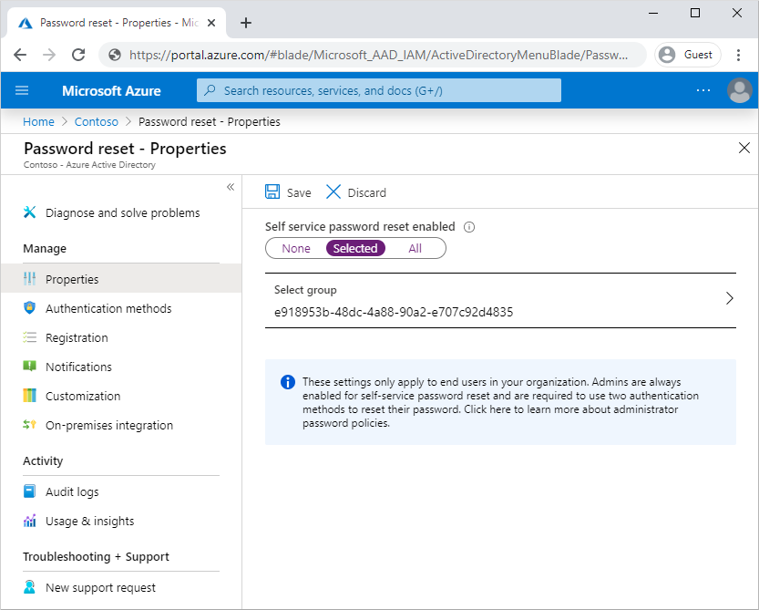
Enable Azure AD Self-Service Password Reset
Prerequisites:
A working Azure AD tenant with a license
A user with the Global Administrator role
A non-privileged test user
A group that the test user is a member of
Enable self-service password reset:
via the Azure Portal
Select authentication methods and registration options:
Mobile app notification
Mobile app code
Email
Mobile phone
Office phone
Configure notifications and customizations

Slide 14
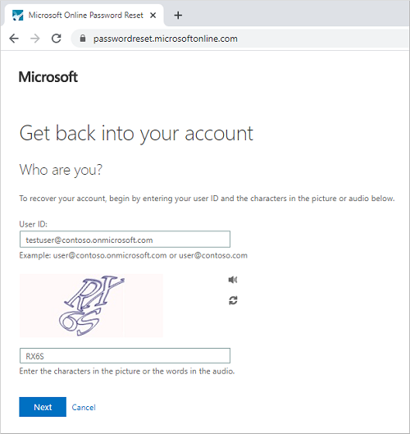
Test Self-Service Password Reset
With SSPR enabled and configured, test the SSPR process as the test user

Slide 15
Self-Service Password Reset (SSPR) Writeback
Password writeback offers the following benefits:
Enforcement of Active Directory Domain Services (AD DS) password policies
Zero-delay feedback
Support for password changes from the Access Panel and Office 365
Support for password writeback when an admin reset the password from the Azure portal
No need for opening inbound ports on the edge firewall

Slide 16
Configure Azure AD Connect Health

Slide 17
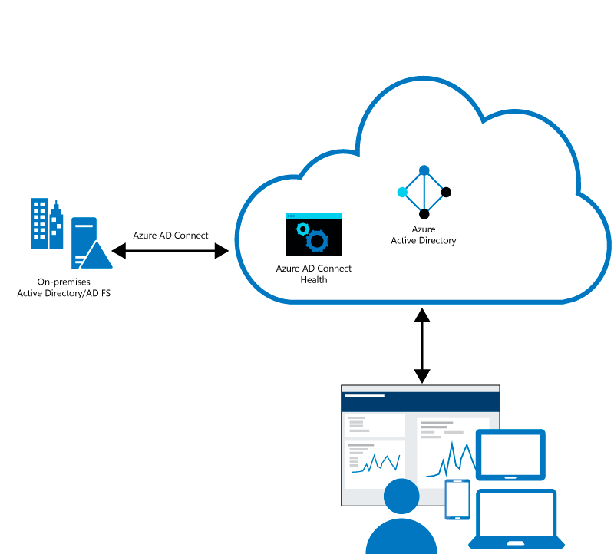
Azure AD health Overview
Azure AD Connect Health helps monitor on-premises identity infrastructure thus ensuring the reliability of the environment
Key benefits:
Enhanced security
Alerts on all critical AD FS system issues
Simplified deployment and management
Rich usage metrics
Enhanced admin experience

Slide 18
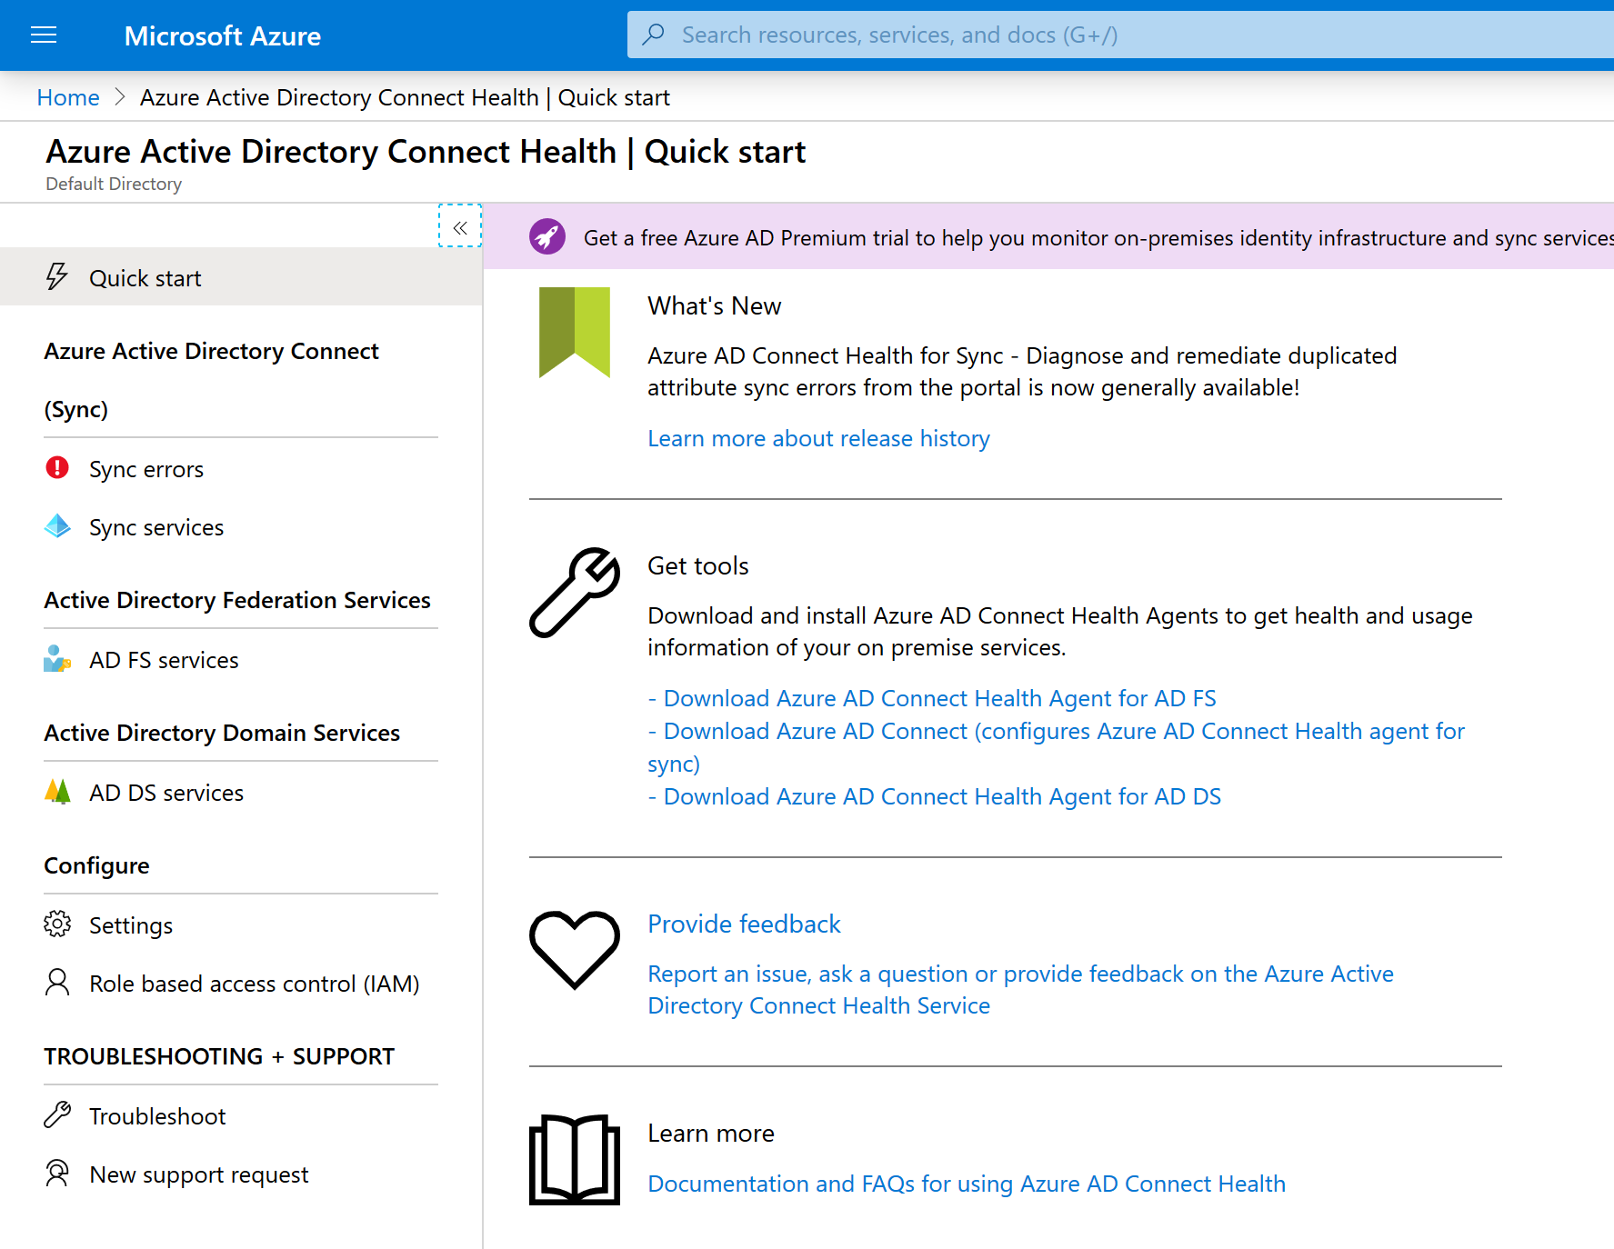
Implement Azure AD Connect Health
Install the Azure AD Connect Health agent
Install the latest version of Azure AD Connect (includes Azure AD Connect Health for sync)
Monitor Azure AD Connect Health portal
Views of alerts
Performance monitoring
Usage analytics

Slide 19

Module Review Questions

